Slide 1
Halibut PSC Evaluation
Simulation Model

Slide 2
Equilibrium Conditions
Determining Ro
Set F for all sectors to 0
Search over values for Ro until
Equilibrium SSB matches assessed level: 720 M lbs.

Slide 3
Equilibrium Conditions
B_{start}=1,500 M lbs
SSB₀=709 M lbs
SSB₀=709 M lbs

Slide 4
Equilibrium Conditions
B_{start}=750 M lbs
SSB₀=709 M lbs
SSB₀=709 M lbs

Slide 5
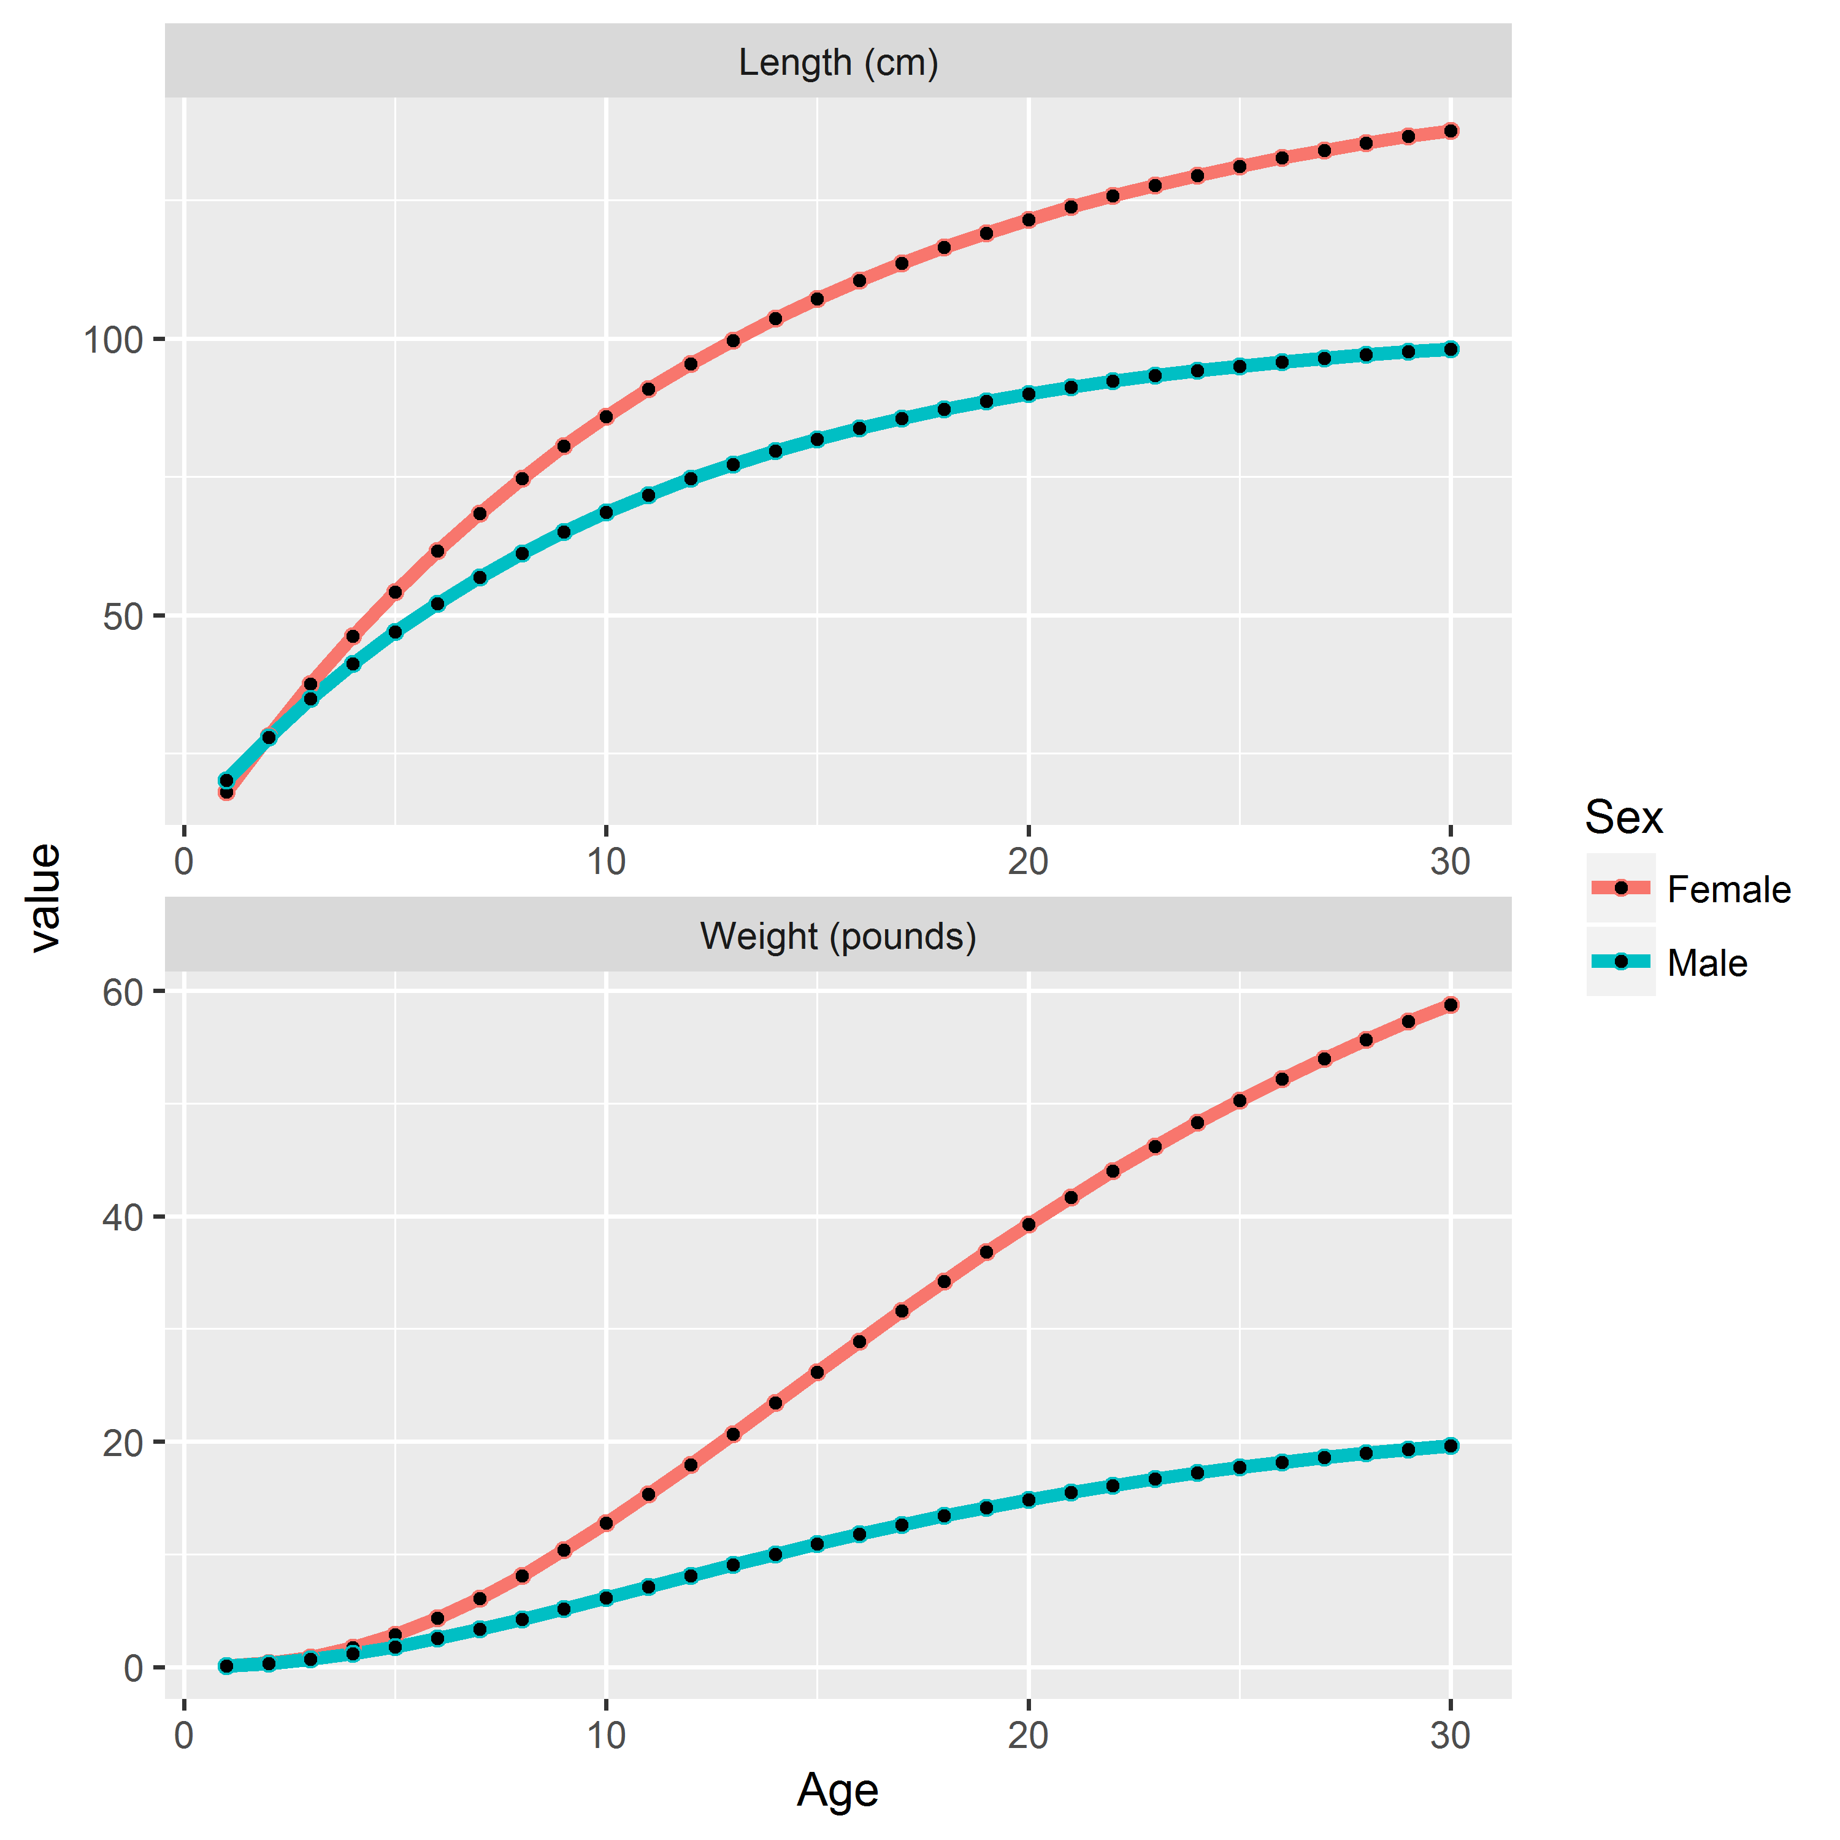
Equilibrium Conditions
B_{start}=1,500 M lbs

Slide 6
Equilibrium Conditions
B_{start}=1,500 M lbs

